Slide 1
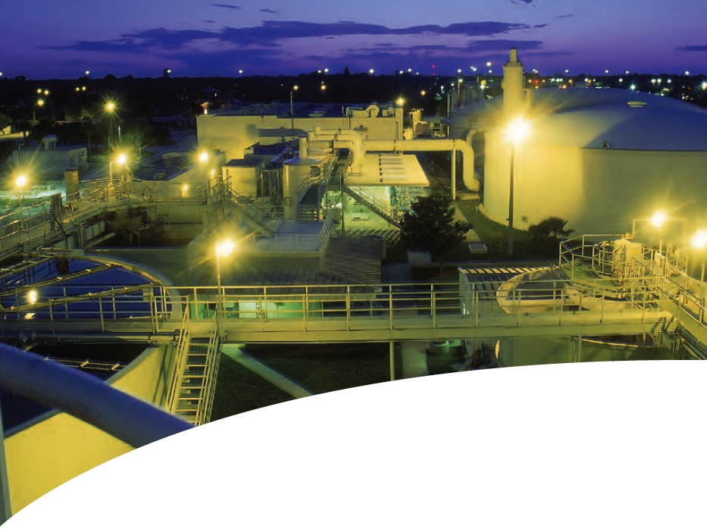

Electrical Solutions for Water and Wastewater Industry

Slide 2

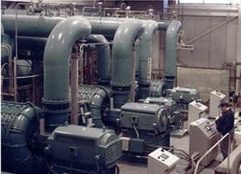
Key Water/ Wastewater Business & Operation Drivers
Electrical Solutions for Water and Wastewater Industry
Business Drivers
Provincial and Federal Agencies
Housing Market
Weather
Aging Infrastructure
Operation Drivers
Energy Efficiency
Resource Recovery
Security
Waste Reduction
Electrical Division

Slide 3
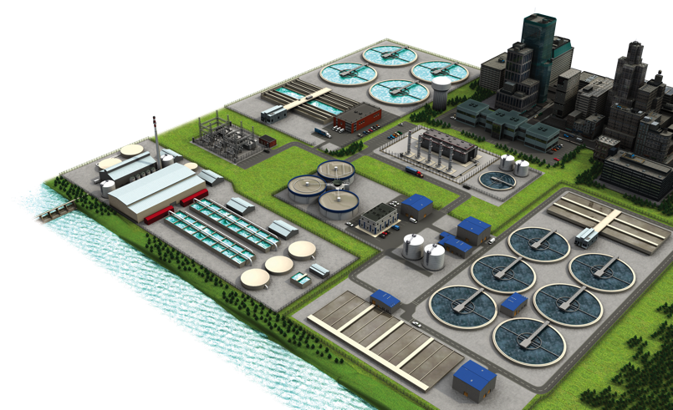
T&B Engineered
Solutions for Every
Application Area
Electrical Solutions for Water and Wastewater Industry
^{Wastewater Treatment}
^{Lift Station}
^{Water Treatment}
^{Desalination Plant}
^{Grey Water Treatment}
^{Industrial Water Treatment}
^{Substation}
Electrical Division

Slide 4








T&B Chemical Industry Application Solutions
Electrical Solutions for Water and Wastewater Industry
Continuous Operation & Sustainability
Corrosion & Harsh Environment Protection
Liquid Ingress Protection
Safety
Hazardous Location Protection
Power Quality Efficiency & Reliability
Grounding & Bonding
Total Project Cost Reduction
Electrical Division

Slide 5
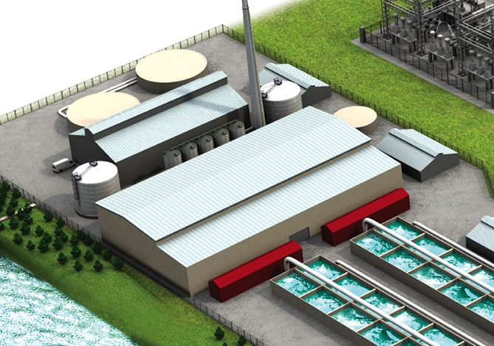

Electrical Solutions for Water and Wastewater Industry
Continuous Operation & Sustainability
Electrical Division

Slide 6

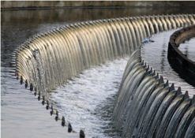

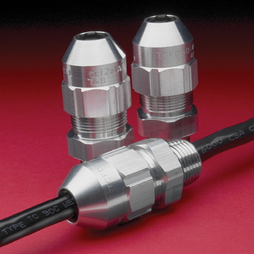
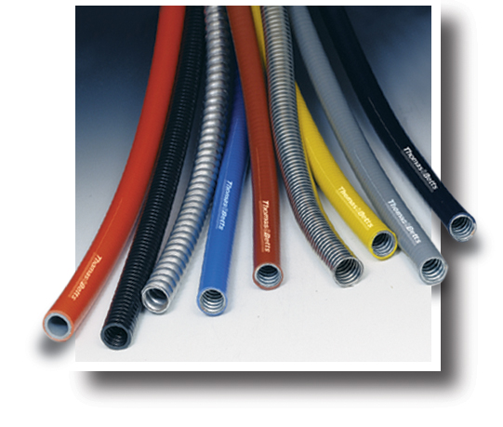
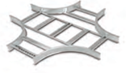
Continuous Operation & Sustainability
Electrical Solutions for Water and Wastewater Industry
^{Thomas & Betts brands}
^{for continuous operation}
^{& sustainability}
To help avoid cost prohibitive, unscheduled downtime and ensure compliance with environmental regulations, Thomas & Betts offers a range of electrical solutions aimed at safe and continuous operations.
^{Blackburn®}
^{Carlon®}
^{Elastimold®}
^{Emergi-Lite®}
^{Hi-TechTM}
^{Homac®}
^{Joslyn Hi-Voltage®}
^{Kopex-ExTM}
^{Lumacell®}
^{OcalTM}
^{PMA®}
^{Ready-Lite®}
^{Red-Dot®}
^{Reznor®}
^{Russellstoll®}
^{Shrink-KonTM}
^{Sta-Kon®}
^{Superstrut®}
^{T&B® Cable Tray}
^{T&B® Fittings}
Blackburn®
Motor Lead Disconnects
T&B® Fittings
Silver Grip®
T&B® Fittings
Liquatite® Flexible metallic and Nonmetallic Conduits
T&B® Cable Tray
Electrical Division

Slide 7



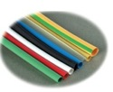
Continuous Operation & Sustainability
Electrical Solutions for Water and Wastewater Industry
^{Thomas & Betts brands}
^{for continuous operation}
^{& sustainability}
In the single most demanding, non-stop operating environments, one single point of failure can lead
to costly — or even disastrous — results.
^{Blackburn®}
^{Carlon®}
^{Elastimold®}
^{Emergi-Lite®}
^{Hi-TechTM}
^{Homac®}
^{Joslyn Hi-Voltage®}
^{Kopex-ExTM}
^{Lumacell®}
^{OcalTM}
^{PMA®}
^{Ready-Lite®}
^{Red-Dot®}
^{Reznor®}
^{Russellstoll®}
^{Shrink-KonTM}
^{Sta-Kon®}
^{Superstrut®}
^{T&B® Cable Tray}
^{T&B® Fittings}
^{Russellstoll®}
Pin-and-Sleeve Interconnections
^{OcalTM}
^{PVC-Coated Conduit Systems}
PMA®
High-Temperature Nylon
Conduit and Fittings
®
^{Shrink-KonTM}
^{Wire and Connector Insulation}
Electrical Division

Slide 8
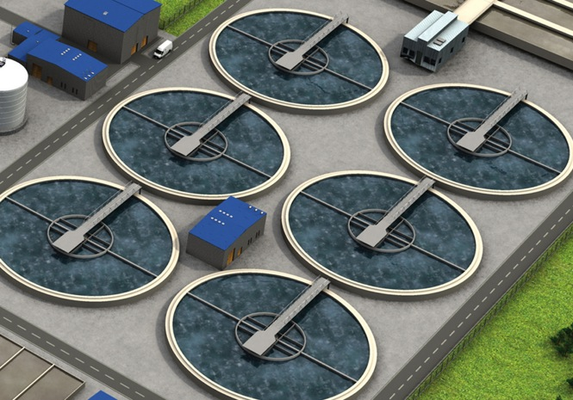

Electrical Solutions for Water and Wastewater Industry
Corrosion & Harsh
Environment Protection
Electrical Division
Notes:
8

Slide 9
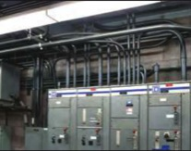
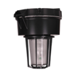



Corrosion & Harsh Environment Protection
Electrical Solutions for Water and Wastewater Industry
^{Thomas & Betts brands}
^{for corrosion & harsh}
^{environment protection}
Corrosion is the enemy of electrical systems. According to NACE International, corrosion costs in the North American market is estimated to be over $1.3 billion annually.
^{Blackburn®}
^{Carlon®}
^{Emergi-Lite®}
^{Hazlux®}
^{Kopex-ExTM}
^{Lumacell®}
^{OcalTM}
^{PMA®}
^{Ready-Lite®}
^{Red•Dot®}
^{Reznor®}
^{Russellstoll®}
^{Sta-Kon®}
^{Superstrut®}
^{T&B® Cable Tray}
^{T&B® Fittings}
^{Ty-Rap®}
Problems caused by corrosion include:
Equipment failure and shortened life
Poor electrical system reliability caused by high-resistance connections
Long maintenance repair time due to corroded parts
Safety hazards at the grounding level and from product contamination
Added labor expenses
OcalTM
OCAL-BLUETM PVC-Coated Conduit
Hazlux®
HazCoteTM Kynar® Coated Lighting Fixtures
Ty-Rap®
Stainless Steel Cable Ties
Kopex-Ex™
Stainless Steel Flexible Conduit
and Liquidtight Fittings
Electrical Division
Notes:
9

Slide 10
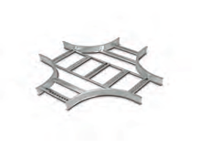


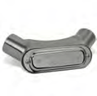
Corrosion & Harsh Environment Protection
Electrical Solutions for Water and Wastewater Industry
^{Thomas & Betts brands}
^{for corrosion & harsh}
^{environment protection}
Corrosion is a natural and inevitable process.
It cannot be eliminated, but it can be managed
and controlled with the right products.
^{Blackburn®}
^{Carlon®}
^{Emergi-Lite®}
^{Hazlux®}
^{Kopex-ExTM}
^{Lumacell®}
^{OcalTM}
^{PMA®}
^{Ready-Lite®}
^{Red•Dot®}
^{Reznor®}
^{Russellstoll®}
^{Sta-Kon®}
^{Superstrut®}
^{T&B® Cable Tray}
^{T&B® Fittings}
^{Ty-Rap®}
T&B® Cable Tray
Aluminum Cable Tray
Superstrut®
Nonmetallic Modular Framing Channel and Accessories
PMA®
Nylon Cable Protection Systems
T&B® Fittings
Type 316 Stainless Steel
Form 8 Conduit Bodies
Electrical Division
Notes:
10

Slide 11
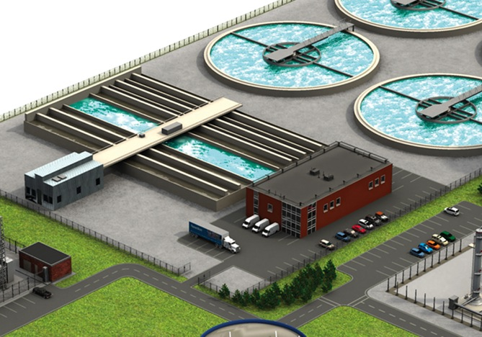

Electrical Solutions for Water and Wastewater Industry
Liquid Ingress Protection
Electrical Division
Notes:
11

Slide 12
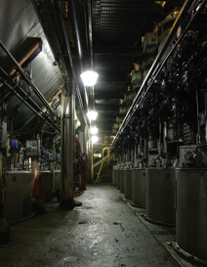

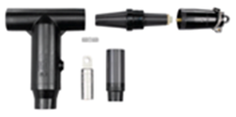


Liquid Ingress Protection
Electrical Solutions for Water and Wastewater Industry
^{Thomas & Betts brands}
^{for liquid ingress}
^{protection}
A single drop of water seeping into an electrical control box is all it takes to knock out a Water/Wastewater facility’s production line for days.
Carlon®
Elastimold®
Emergi-Lite®
Hazlux®
Homac®
Iberville®
Kopex-ExTM
Lumacell®
OcalTM
PMA®
Ready-Lite®
Red•Dot®
Reznor®
Russellstoll®
Shrink-KonTM
Sta-Kon®
T&B® Fittings
Homac®
Flood-SealTM and Squid® Products
Elastimold®
Cable Accessories
T&B® Fittings
Stainless Steel Liquidtight
Conduit and Cord Fittings
OcalTM
OCAL-BLUETM PVC-Coated NEMA
Type 4X Form 8 Conduit Bodies
Electrical Division
Notes:
12

Slide 13



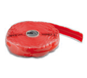

Liquid Ingress Protection
Electrical Solutions for Water and Wastewater Industry
^{Thomas & Betts brands}
^{for liquid ingress}
^{protection}
The financial impact of allowing liquid to migrate into electrical systems can be significant — whether the result of downtime
or having to replace damaged components.
Carlon®
Elastimold®
Emergi-Lite®
Hazlux®
Homac®
Iberville®
Kopex-ExTM
Lumacell®
OcalTM
PMA®
Ready-Lite®
Red•Dot®
Reznor®
Russellstoll®
Shrink-KonTM
Sta-Kon®
T&B® Fittings
Red•Dot®
Code KeeperTM Weatherproof
While-In-Use Covers
PMA®
Flexible Nylon Conduit Systems
Homac®
Flood-SealTM Multi-Port Connectors
Sta-Kon®
Shrink-KonTM Wire and Connector Insulation Products
Electrical Division
Notes:
13

Slide 14
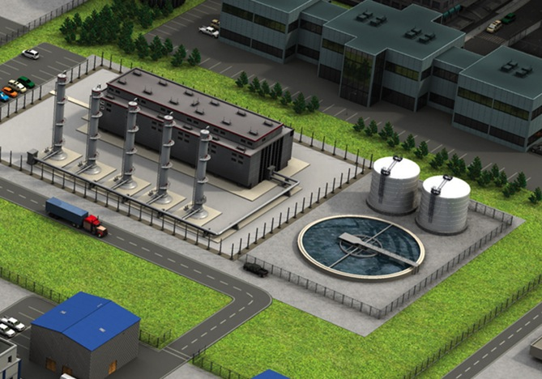

Electrical Solutions for Water and Wastewater Industry
Hazardous Location Protection
Electrical Division
Notes:
14

Slide 15
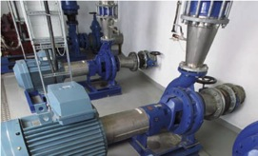


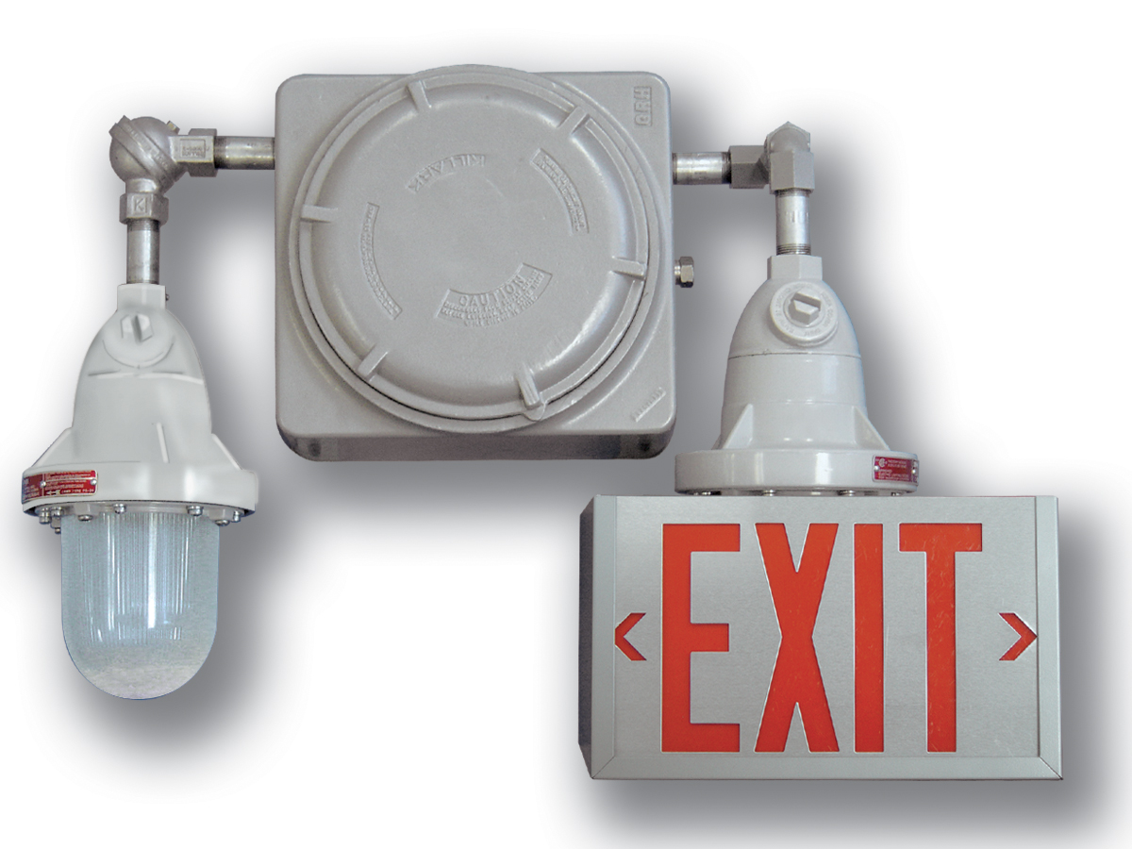

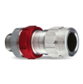
Hazardous Location Protection
Electrical Solutions for Water and Wastewater Industry
^{Thomas & Betts brands}
^{for hazardous location}
^{protection}
There is always a concern at Water/Wastewater installations about the significant presence of gases and vapors.
Emergi-Lite®
E-Z-Code®
Hazlux®
Kopex-ExTM
Lumacell®
Ready-Lite®
Reznor®
Russellstoll®
T&B® Cable Tray
T&B® Fittings
Typical hazardous locations include:
Water/ Wastewater plant process areas
Booster stations and valve areas along pipelines
Loading and unloading areas in terminals
Storage areas for tanks, barrels and trucks
Hazlux®
Hazardous Location Lighting
Russellstoll®
MaxGard® Pin-and-Sleeve Connectors
Emergi-Lite® /Lumacell® /Ready-Lite®
Hazardous Location Emergency Lighting
KopexTM
Kopex-ExTM Explosion Proof
Conduit Systems
T&B® Fittings
STAR TECK XP® Stainless Steel
and Aluminum Fittings
Electrical Division
Notes:
15

Slide 16
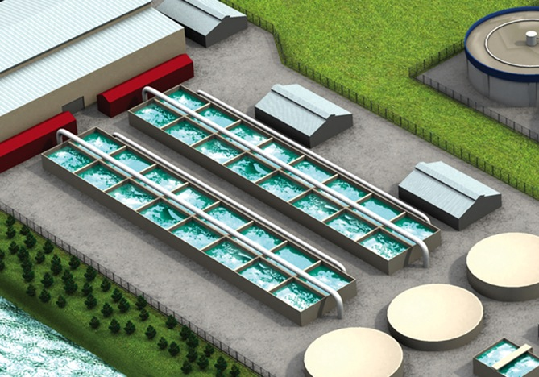

Electrical Solutions for Water and Wastewater Industry
Safety
Electrical Division
Notes:
16

Slide 17
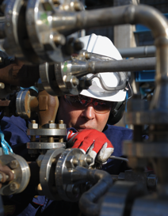





Safety
Electrical Solutions for Water and Wastewater Industry
^{Thomas & Betts brands}
^{for safety}
Blackburn®
Carlon®
Elastimold®
Emergi-Lite®
E-Z-Code®
Hazlux®
Hi-TechTM
Homac®
Joslyn Hi-Voltage®
KopexTM
Lumacell®
Ready-Lite®
OcalTM
Red•Dot®
Russellstoll®
Shrink-KonTM
Sta-Kon®
Steel-City®
Superstrut®
T&B® Cable Tray
T&B® Fittings
Ty-Rap®
The goal of safety practices is zero accidents,
^{zero injuries and zero deaths.}
The major stakeholders in safety solutions are:
• Municipal, Provincial and Federal Agencies
^{• The business/organization}
^{• The employee(s)}
^{• The environment/society}
Hazlux®
Quick Pole
Russellstoll®
Safe Ground Indicator and
Lightning Protection
Emergi-Lite®/Lumacell®/Ready-Lite®
Emergency Lighting Systems
E-Z-CODE®
Safety Labels, Tags, Signs and Barricade Tapes
Electrical Division
Notes:
17

Slide 18
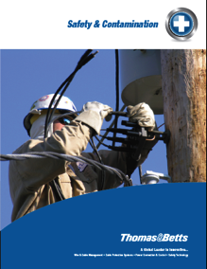

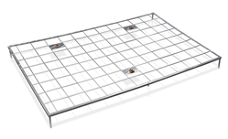
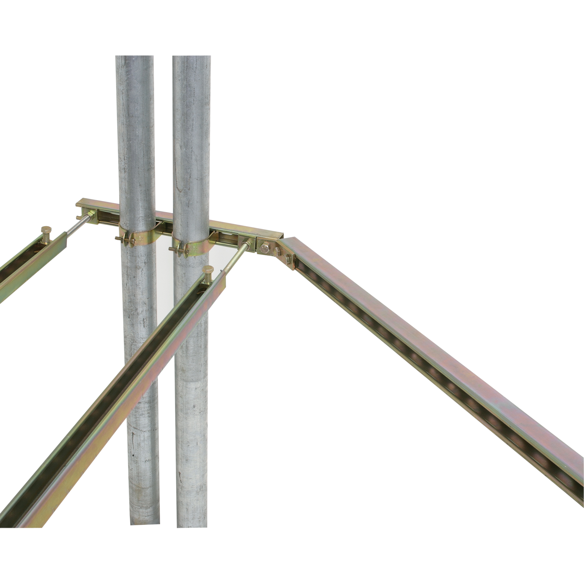
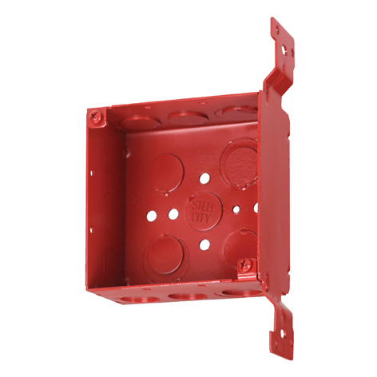
T&B Solutions for Safety
& Contamination
Electrical Solutions for Water and Wastewater Industry
^{Thomas & Betts brands}
^{for safety}
Blackburn®
Carlon®
Elastimold®
Emergi-Lite®
E-Z-Code®
Hazlux®
Hi-TechTM
Homac®
Joslyn Hi-Voltage®
KopexTM
Lumacell®
Marrette®
Ready-Lite®
OcalTM
Red•Dot®
Reznor®
Russellstoll®
Shrink-KonTM
Sta-Kon®
Steel-City®
Superstrut®
T&B® Cable Tray
T&B® Fittings
Ty-Rap®
No one is immune to safety and contamination concerns.
Contamination and safety concerns are not market
specific. They affect workers, production schedules
and the bottom line across a broad spectrum
of industries.
Ty-Rap®
Detectable Cable Ties
Blackburn®
Metallic Gradient Control Mat
Superstrut®
Seismic Bracing
Steel City®
Fire Alarm Boxes and Fittings
Electrical Division
Notes:
18

Slide 19
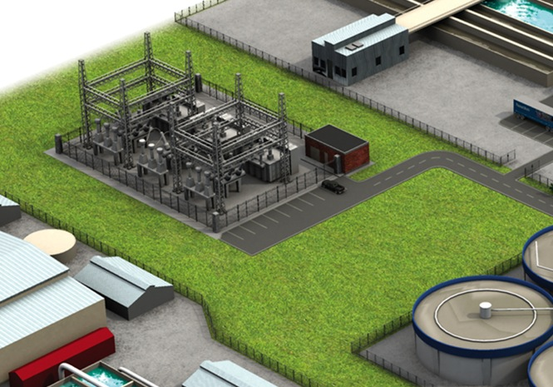

Electrical Solutions for Water and Wastewater Industry
Power Quality, Efficiency & Reliability
Electrical Division
Notes:
19

Slide 20
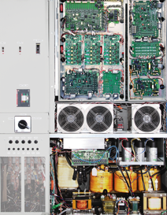
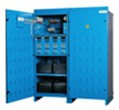
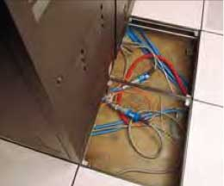

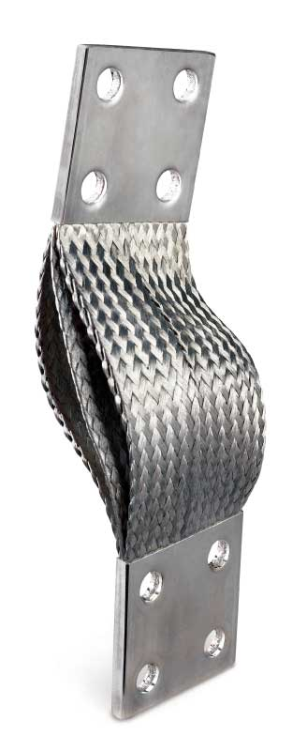
Power Quality, Efficiency & Reliability
Electrical Solutions for Water and Wastewater Industry
^{Thomas & Betts brands}
^{for power quality,}
^{efficiency & reliability}
Maintaining service to motors, pumps and monitoring equipment is the difference between a smooth operation and a visit from the Federal or Provincial agencies. In this critical industry, the need for stable power is paramount.
Blackburn®
Boreal®
Elastimold®
Emergi-Lite®
Fisher PierceTM
Hi-TechTM
Homac®
Joslyn Hi-Voltage®
Lumacell®
Microlectric®
Ready-Lite®
Russellstoll®
Emergi-Lite® /Lumacell® /Ready-Lite®
Central Power Supplies
RussellStoll®
Computer System Plugs
Blackburn®
Compression lugs featuring
the Color-Keyed® System
Boreal®
Flexible Braids
Electrical Division

Slide 21
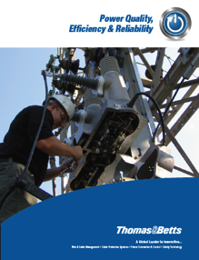
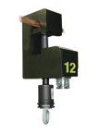

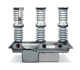

Power Quality, Efficiency & Reliability
Electrical Solutions for the Oil and Gas Industry
^{Thomas & Betts brands}
^{for power quality,}
^{efficiency & reliability}
In today’s world, critical electrical equipment
must be reliable and operational — 24 hours a day,
seven days a week.
Blackburn®
Boreal®
Elastimold®
Emergi-Lite®
Fisher PierceTM
Hi-TechTM
Homac®
Joslyn Hi-Voltage®
Lumacell®
Microlectric®
Ready-Lite®
Russellstoll®
Fisher PierceTM
Faulted Circuit Indicators
Joslyn Hi-Voltage®
Switches and Reclosers
Elastimold®
Switchgear and Cable Accessories
Electrical Division

Slide 22
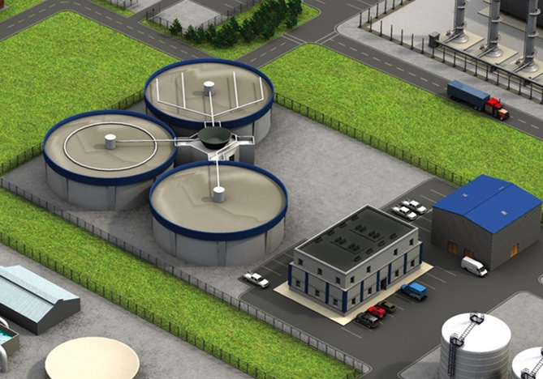

Electrical Solutions for Water and Wastewater Industry
Grounding & Bonding
Electrical Division

Slide 23
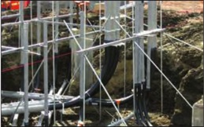



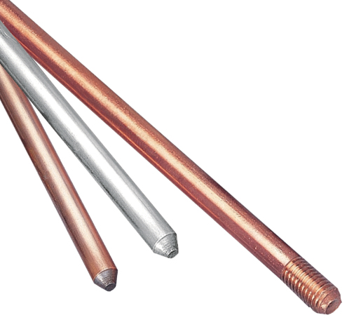
Grounding & Bonding
Electrical Solutions for Water and Wastewater Industry
^{Thomas & Betts brands}
^{for grounding & bonding}
Grounding the electrical system provides a means in which conductive equipment is connected to an earth potential grid via the grounding conductors and electrodes. This prevents potential differences between conductive equipment and grounded structures.
Blackburn®
Boreal®
Elastimold®
E-Z-CODE®
Fisher PierceTM
Iberville ®
Russellstoll®
Sta-Kon®
T&B® Fittings
Blackburn®
Exothermic Welding System
Blackburn®
Mechanical Grounding Connectors
Boreal®
High-Quality
Flexible Connectors
Blackburn®
Ground Rods
Electrical Division

Slide 24

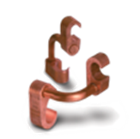


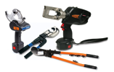

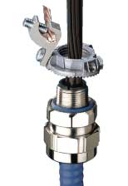
Grounding & Bonding
Electrical Solutions for Water and Wastewater Industry
^{Thomas & Betts brands}
^{for grounding & bonding}
An improperly installed or grounded electrical system can cause power failure, which often leads to significant safety, production and operational concerns.
Blackburn®
Boreal®
Elastimold®
E-Z-CODE®
Fisher PierceTM
Iberville®
Russellstoll®
Sta-Kon®
T&B® Fittings
Blackburn®
E-Z-Ground® Compression Connectors
Russellstoll®
Safe Ground Indicator System
Blackburn®
Crimp Tools and Die Code Systems
T&B® Fittings
Grounding Fittings
Electrical Division

Slide 25
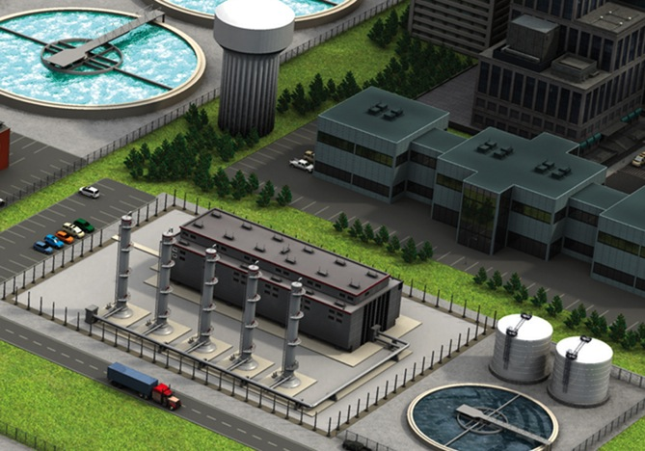

Electrical Solutions for the Water / Wastewater Industry
Total Project Cost Reduction
Electrical Division

Slide 26
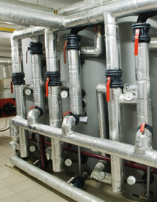

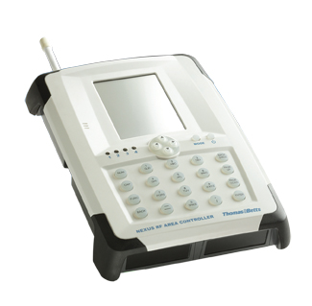
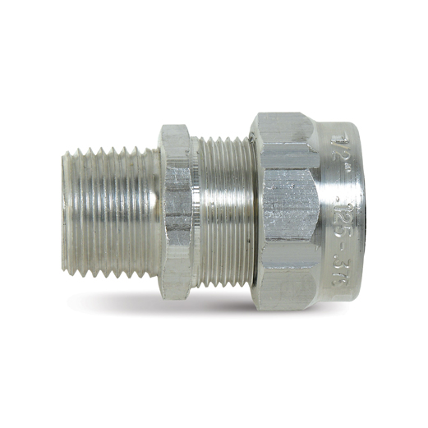
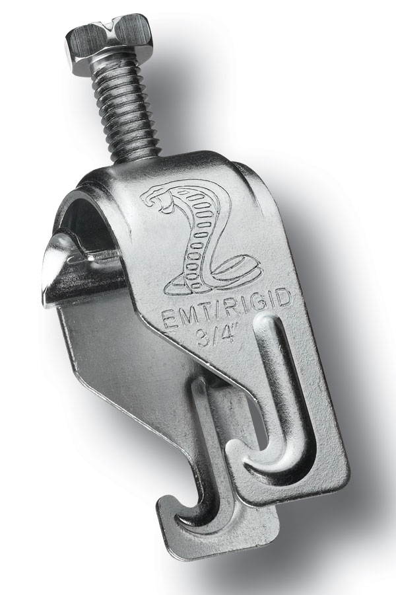
Total Project Cost Reduction
Electrical Solutions for the Water / Wastewater Industry
Thomas & Betts brands for total project cost reduction
Work smarter and eliminate waste. Whether it’s labor, material, logistics or processes, facility managers must look for the most efficient way to get the job done.
Blackburn®
Carlon®
Emergi-Lite®
Hazlux®
Iberville®
Lumacell®
Marrette®
Microlectric®
NuTek®
Kopex-Ex™
PMA®
Ready-lite®
Shrink-KonTM
Sta-Kon®
Steel City®
Superstrut®
T&B® Cable Tray
T&B® Fittings
Ty-Rap®
Hazlux®
Quick PoleTM
Light Fixture Mounting Assembly
Emergi-Lite® /Lumacell® /Ready-Lite®
Nexus Emergency Lighting
Management System
T&B® Fittings
Ranger® Cord Connectors
Superstrut®
Cobra Clamp
Electrical Division

Slide 27
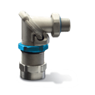
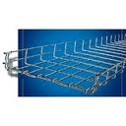
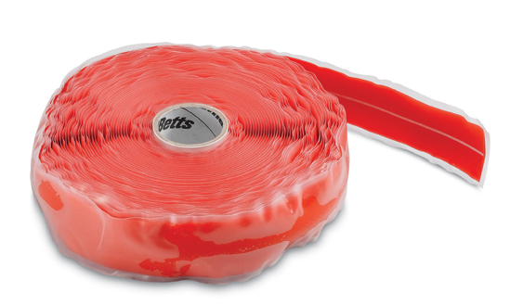

Total Project Cost Reduction
Electrical Solutions for the Water / Wastewater Industry
Thomas & Betts brands for total project cost reduction
Innovative, high quality products can help reduce the overall costs associated with maintaining the electrical systems within Water/Wastewater treatment facilities. From reduced maintenance and installation downtime to major reduction in inventory investments, all these savings can add up quickly.
Blackburn®
Carlon®
Emergi-Lite®
Hazlux®
Iberville®
Lumacell®
Marrette®
Microlectric®
NuTek®
Kopex-Ex™
PMA®
Ready-lite®
Shrink-KonTM
Sta-Kon®
Steel City®
Superstrut®
T&B® Cable Tray
T&B® Fittings
Ty-Rap®
T&B® Fittings
Star Teck Extreme® DirectorTM
T&B® Cable Tray
Express Tray®
Shrink-KonTM
Self Fusing Insulation Tape
Marrette®
Wide Range Wire Connector
Electrical Division

Slide 28
Thank You!!!
Electrical Solutions for Water and Wastewater Industry
Electrical Division

